Slide 1
Software Development on Java
Dzmitry Marchankau 2023

Slide 2
Cloud solutions
SaaS, PaaS, IaaS
AWS, GCP, Azure
Cloud native

Slide 3
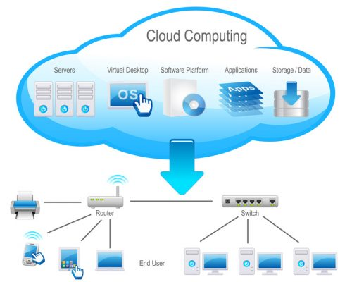
Cloud solutions

Slide 4
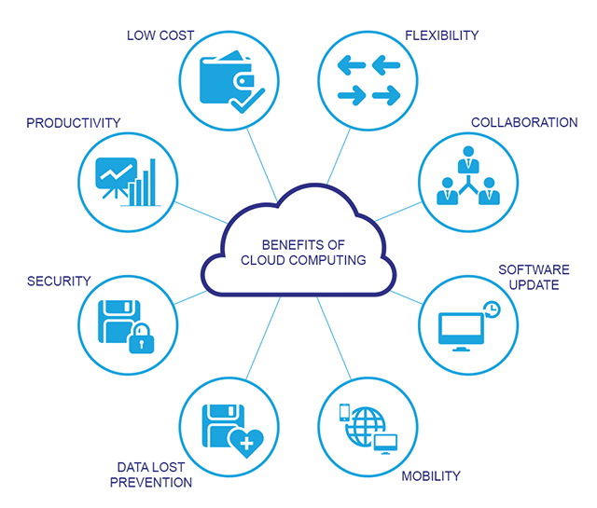
Benefits

Slide 5
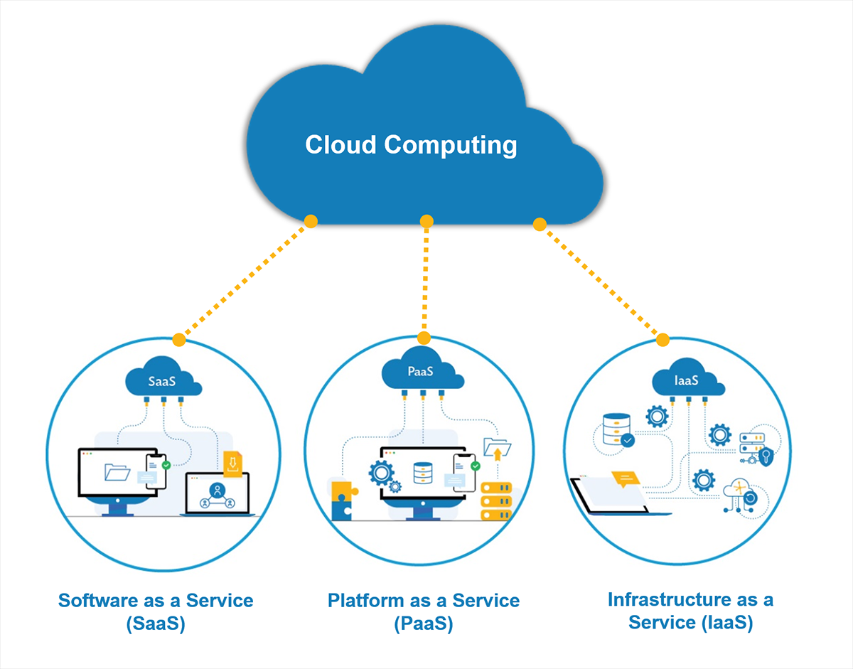
Cloud solutions models

Slide 6
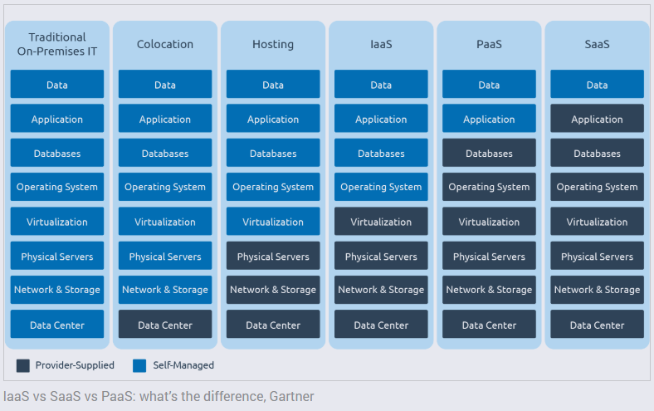
Cloud solutions models

Slide 7
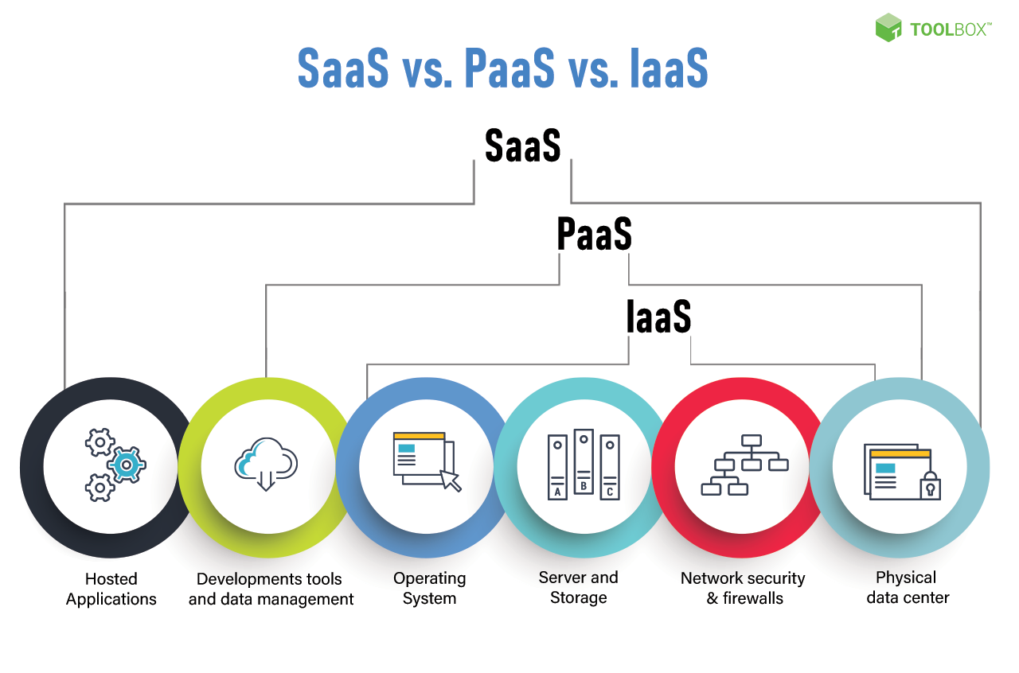
Cloud solutions models

Slide 8
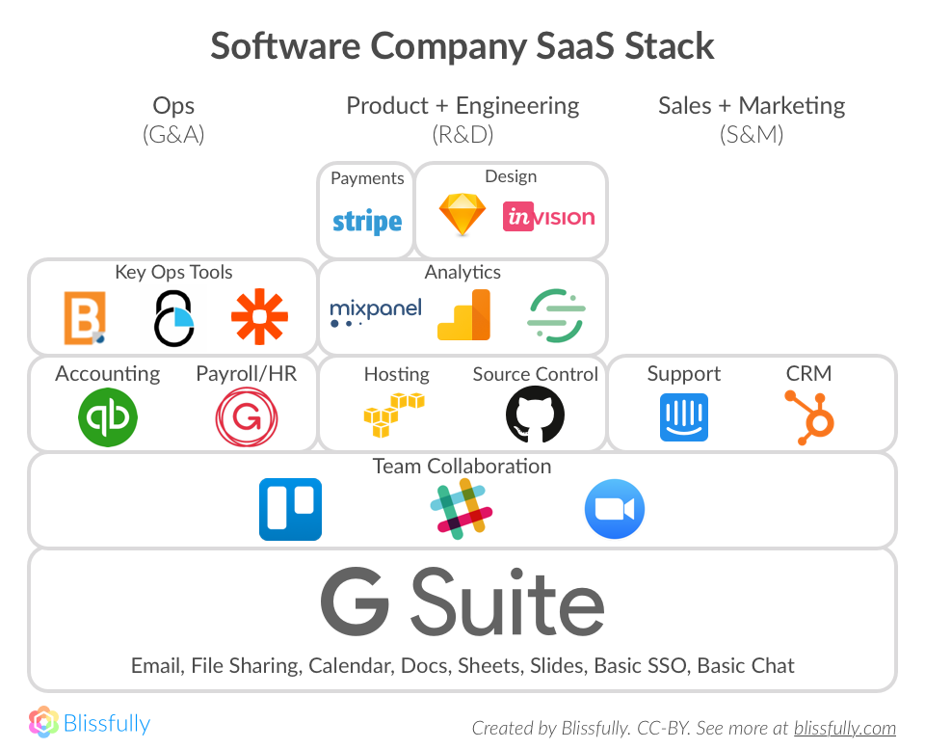
SaaS

Slide 9
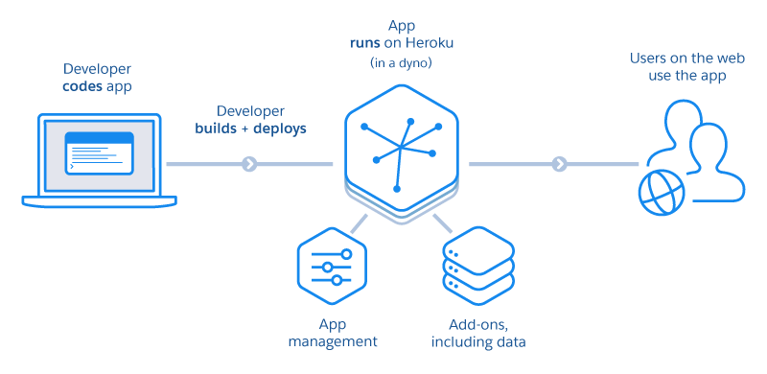
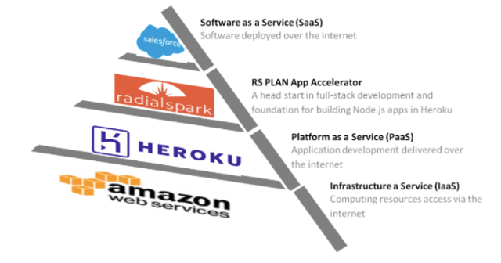
PaaS

Slide 10
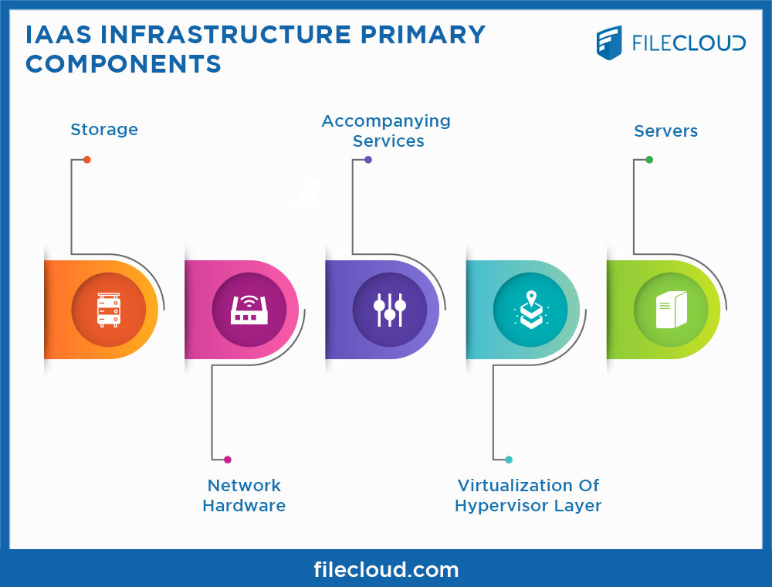
IaaS

Slide 11
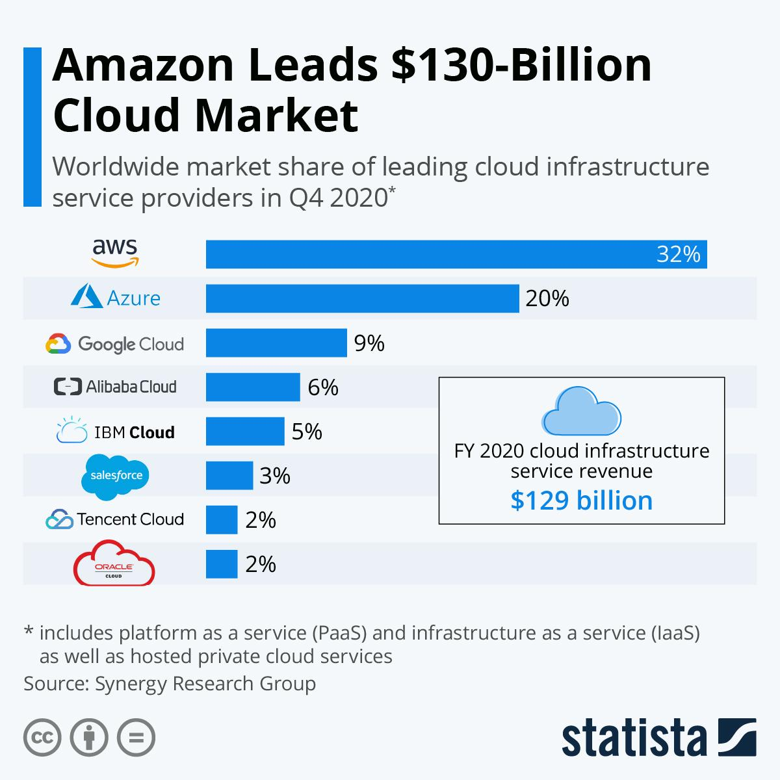
Cloud services market

Slide 12
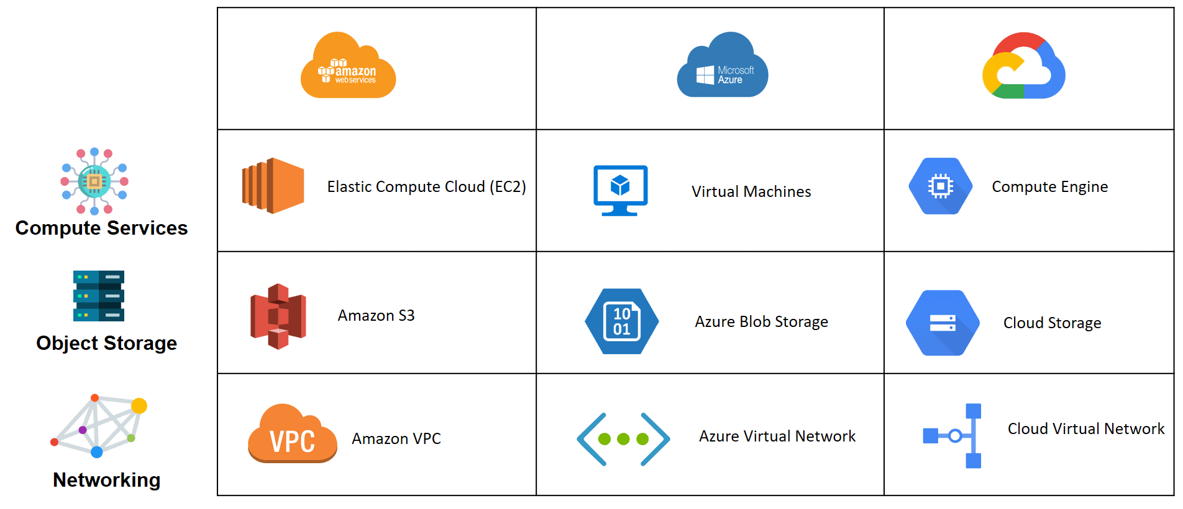
AWS, GCP, Azure

Slide 13
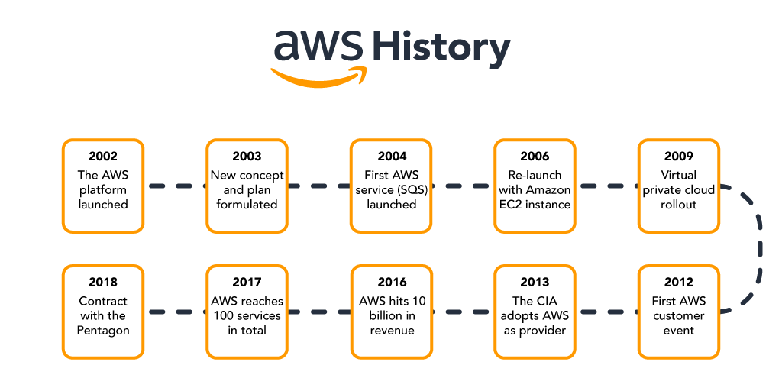
AWS timeline

Slide 14
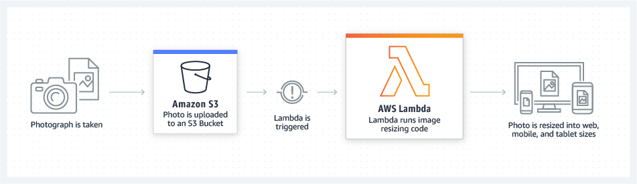
AWS usage example

Slide 15
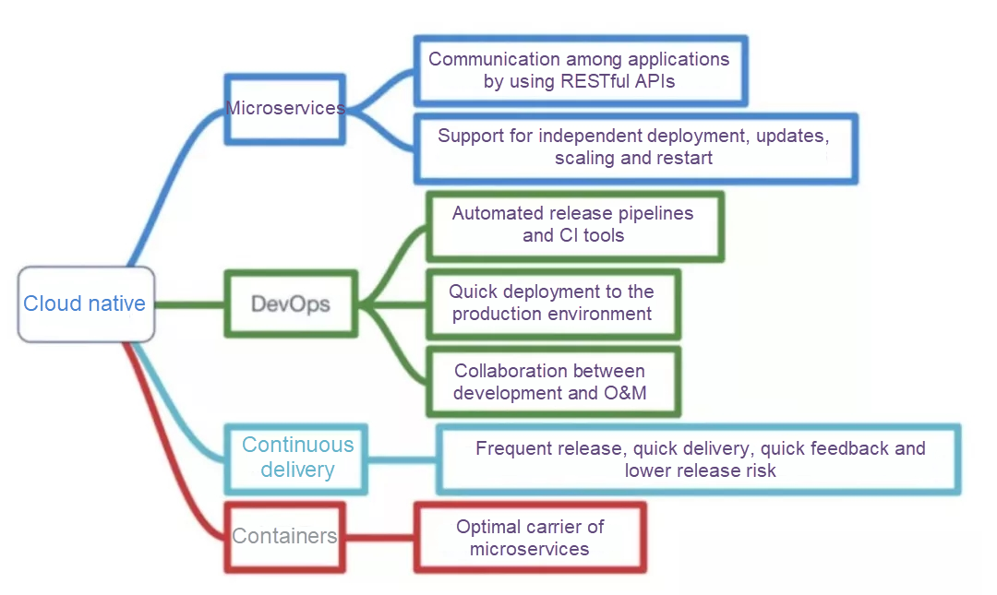
Cloud native

Slide 16
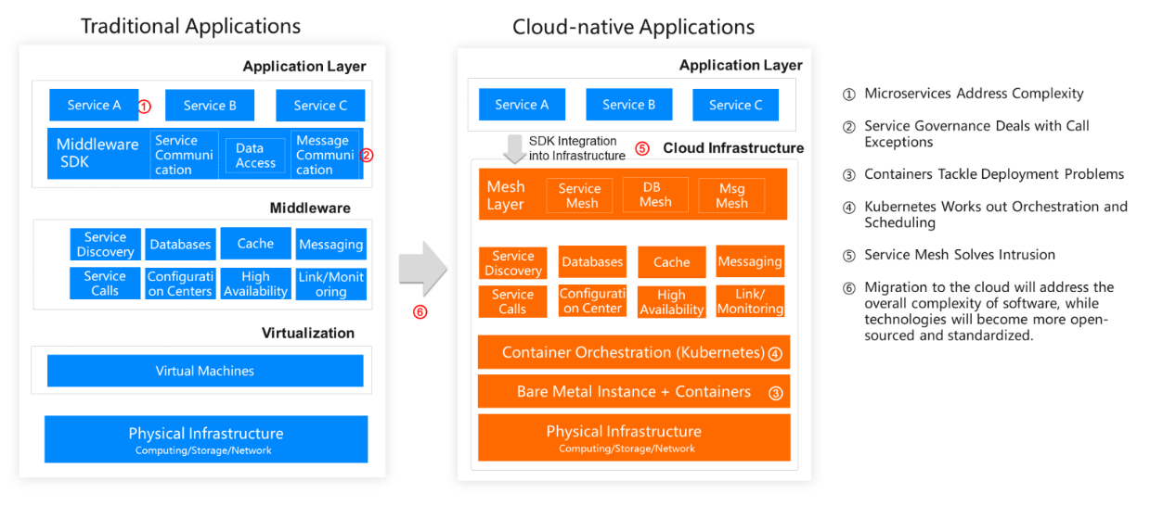
Cloud native applications

Slide 17
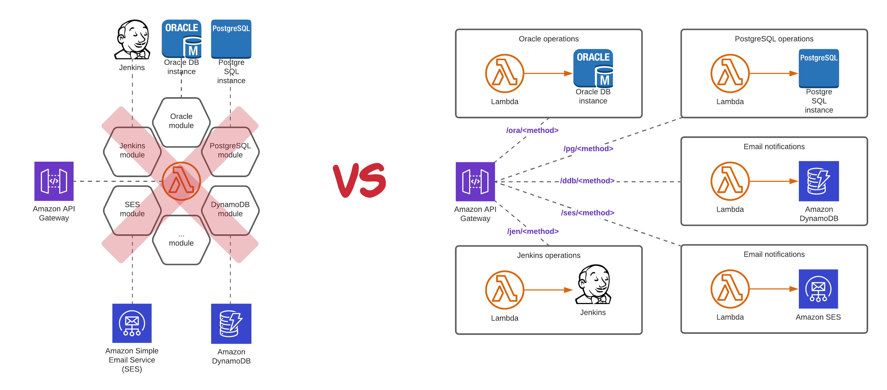
Serverless architecture

Slide 18
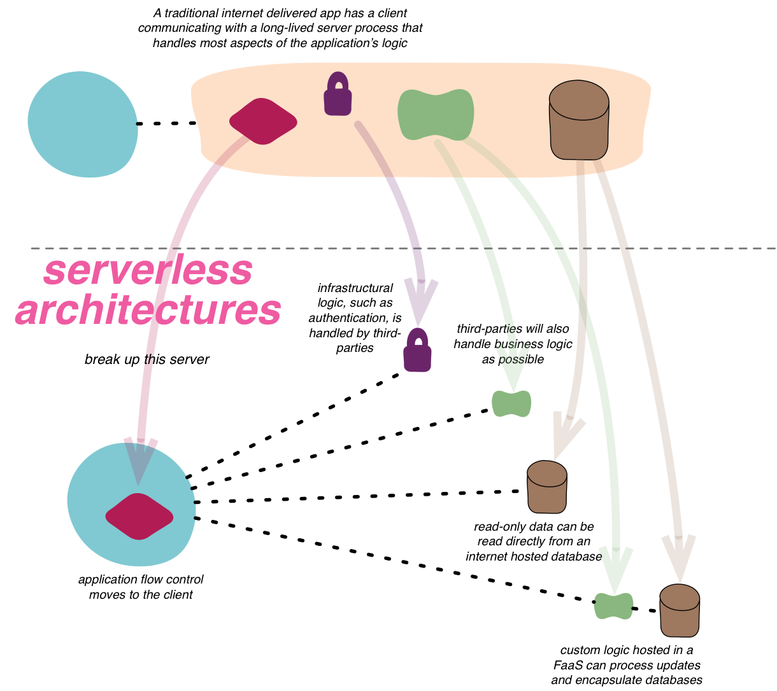
Serverless architecture

Slide 19
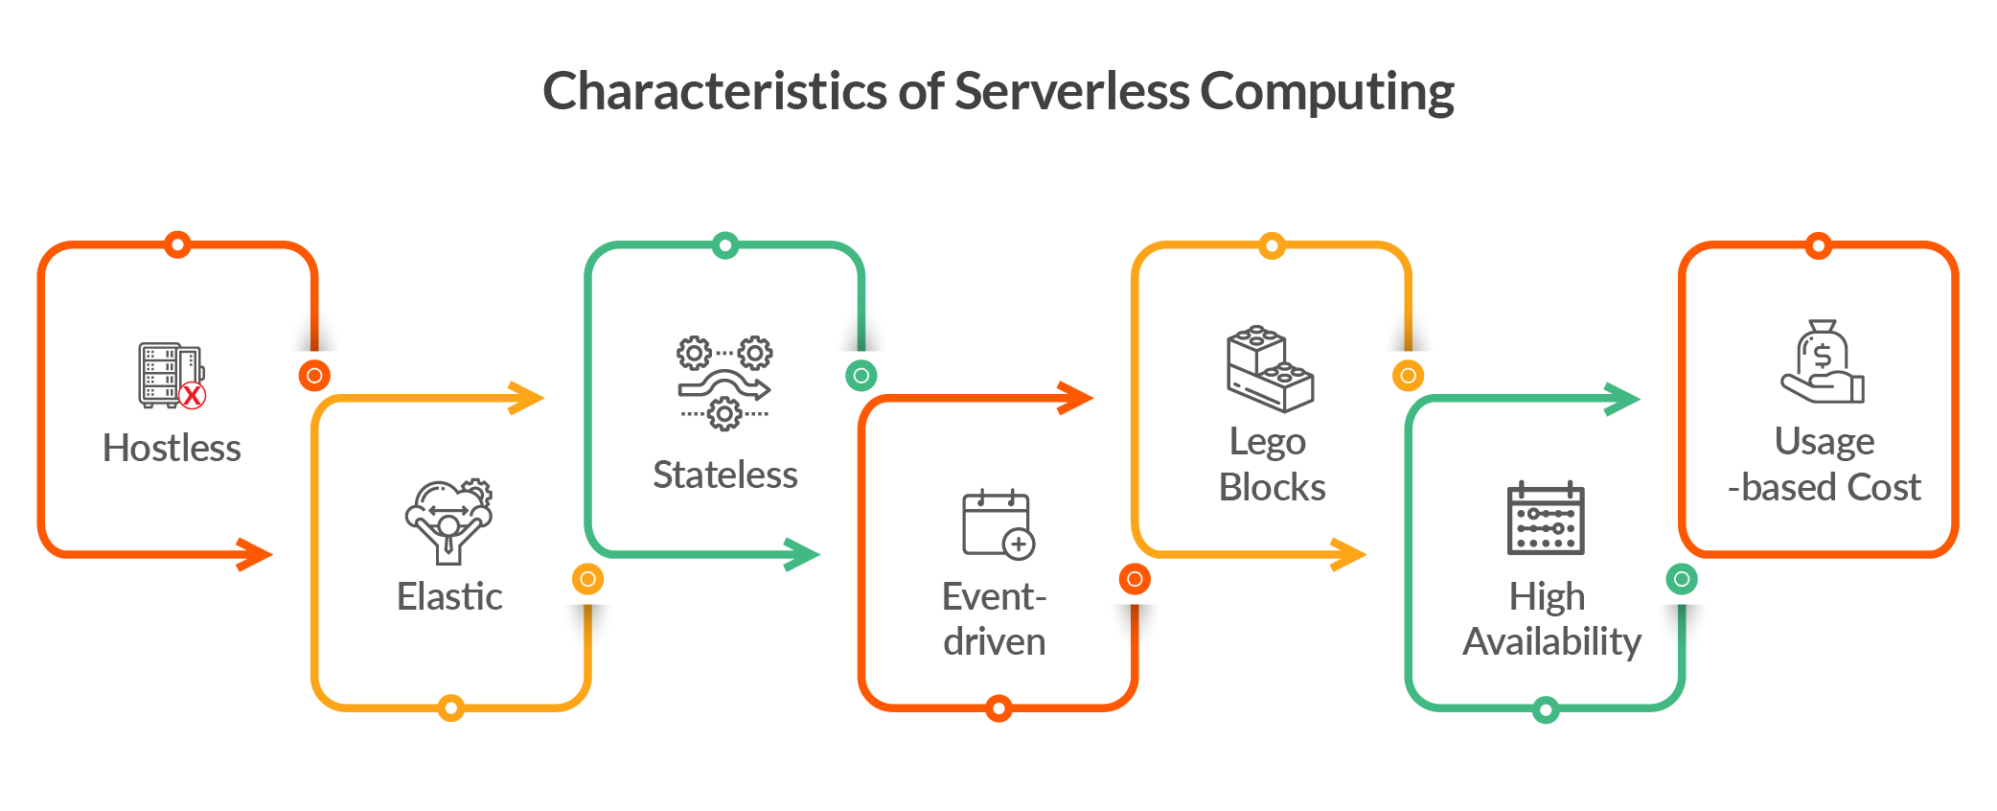
Serverless architecture

Slide 20
Questions ?

